Slide 1


A swarm of robots for encouraging desired social behaviors
Serge Saaybi
Thesis Status update report
TU Delft | 6 April 2021

Slide 2
Currently working on
CS231n: Convolutional Neural Networks for Visual Recognition.
Image Classification: The data-driven approach, K-nearest neighbor , Linear classification I
Loss Functions and Optimization: Linear classification II, Higher-level representations, image features, Optimization, stochastic gradient descent
Introduction to Neural Networks: Backpropagation, Multi-layer Perceptrons, The neural viewpoint
Convolutional Neural Networks: Convolution and pooling, ConvNets outside vision
Training Neural Networks, part I: Activation functions, initialization, dropout, batch normalization
Training Neural Networks, part II: Update rules, ensembles, data augmentation, transfer learning
Deep Learning Software: Caffe, Torch, Theano, TensorFlow, Keras, PyTorch, etc
CNN Architectures: AlexNet, VGG, GoogLeNet, ResNet, etc
Recurrent Neural Networks: RNN, LSTM, GRU, Language modeling, Image captioning, visual question answering, Soft attention
Detection and Segmentation: Semantic segmentation, Object detection, Instance segmentation
Visualizing and Understanding: Feature visualization and inversion, Adversarial examples, DeepDream and style transfer
Generative Models: PixelRNN/CNN, Variational Autoencoders, Generative Adversarial Networks

Slide 3
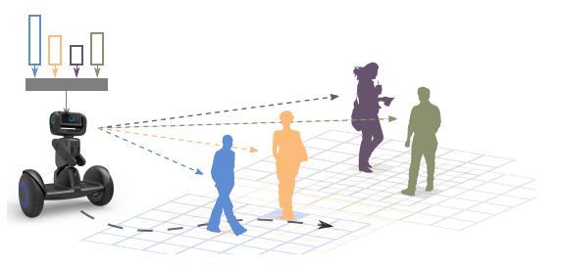
Relevant literature
Crowd-Robot Interaction: Crowd-aware Robot Navigation with Attention-based Deep Reinforcement Learning
This work considers a navigation task where a robot moves towards a goal through a crowd of humans
Tackle the crowd navigation problem by decomposing the Crowd-Robot Interaction into two parts: Human-Robot and Human-Human interactions . These interactions thus affect the robot’s anticipation capability
The model can anticipate human dynamics and navigate in crowds with time efficiency, outperforming state-of-the-art methods.

Slide 4
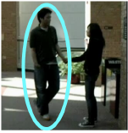
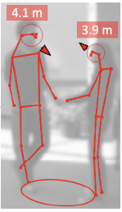
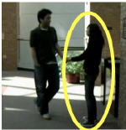
Relevant literature
Perceiving Humans: from Monocular 3D Localization to Social Distancing
Present a new cost effective vision-based method that perceives humans’ locations in 3D and their body orientation from a single image. They leverage this information to recognize social interactions and monitor social distancing
Demonstrate the performance of the method with respect to three applications:
Locating humans in 3D
Detecting social interactions
Verifying the compliance of recent safety measures due to the COVID-19 outbreak
The input is a set of 2D joints extracted from a raw image and the output is the 3D location, orientation and dimensions of a human
Redefine the concept of social distancing beyond a simple measure of distance. Orientations and relative positions of people influence the risk of contagion, and people talking to each other incur higher risks than simply walking apart

Slide 5
Next Steps
Literature review and properly understand the algorithms in:
Vision-based Navigation Using Deep Reinforcement Learning
Two-stage visual navigation by deep neural networks and multi-goal reinforcement learning
Crowd-Robot Interaction: Crowd-aware Robot Navigation with Attention-based Deep Reinforcement Learning
Perceiving Humans: from Monocular 3D Localization to Social Distancing
Autonomous Social Distancing in Urban Environments using a Quadruped Robot
COVID-Robot: Monitoring Social Distancing Constraints in Crowded Scenarios
Check other papers related to:
Image recognition
Collision and crowd avoidance
Finish the course on Convolutional Neural Networks for Visual Recognition
CNN Architectures
Recurrent Neural Networks
Detection and Segmentation
Visualizing and Understanding
Generative Models

